Slide 1
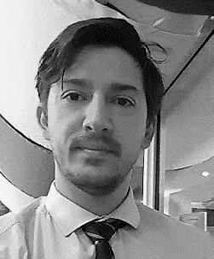





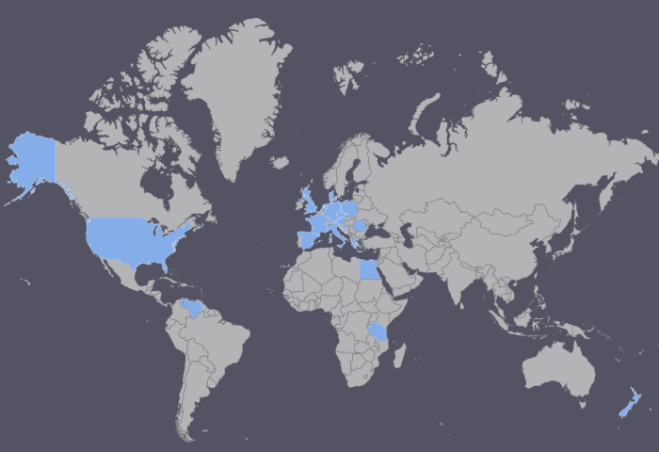




Infographic Resume
Andrei Stoian
Data Analytics with telecommunication SME
Database
Email:
Stoian.couch@gmail.com
Zoom
Stoian.couch
Website
www.spectrumefficiency.co.nz
Phone
027 398 2291
LinkedIn
.com/in/stoianandreimircea
Expertise
Backend
Visualization
Mission statement
11
Years
Eleven years of experience in the telecommunication industry, and the last three years have been within the government.
I use R and SQL to build an automated ETL process with staging tables to support license audit and BI dashboards.
Short Bio
Software
I like building data process. A lot. And, unlike my stakeholders, I consider change, just the necessary step, that when implemented together, it makes a significant impact in their work life. Luckily for my stakeholders, I like resolving the business challenges even more.
I also quite like data visualization – charts and dashboards like sharable data interactions using the Shiny framework.
Live in Wellington Since 2017
Excel
PowerBI
Visual Studio
R
PERSONA
Education
Remote Projects
On weekends I like spending time with my family.
When not eagerly anticipating my next innovation challenge, I will be doing something daunting like diving, mountain biking, snowboarding, or else running or at the gym.
2009
Technical University of Cluj-Napoca Bachelor in Telecommunications
2018
Victoria University Wellington
Master of Information Management
2020
Professional Qualifications
SAS Programming for R Users
Data Science for Business with R / H2O AutoML
USA
Latin America
Europe
Africa
New Zealand

